Slide 1


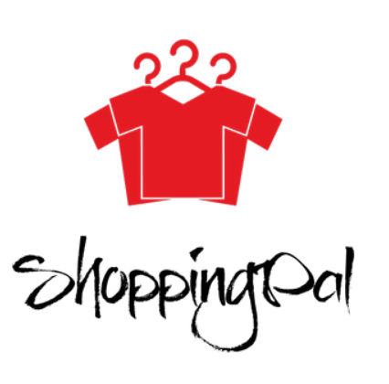
Supervised By: Dr. Samir Shahin
Cairo University
Faculty of Engineering
Presented By
Hussein Mohamed Hesham
Mohamed Osama Hussein
Salma Ibrahim Ahmed
Yousra Hussein Ibrahim
CCE-N481-2019

Slide 2
Agenda
Motivation
Market Survey
Problem Definition
Proposed Solution
Block Diagram

Slide 3



Motivation

Slide 4
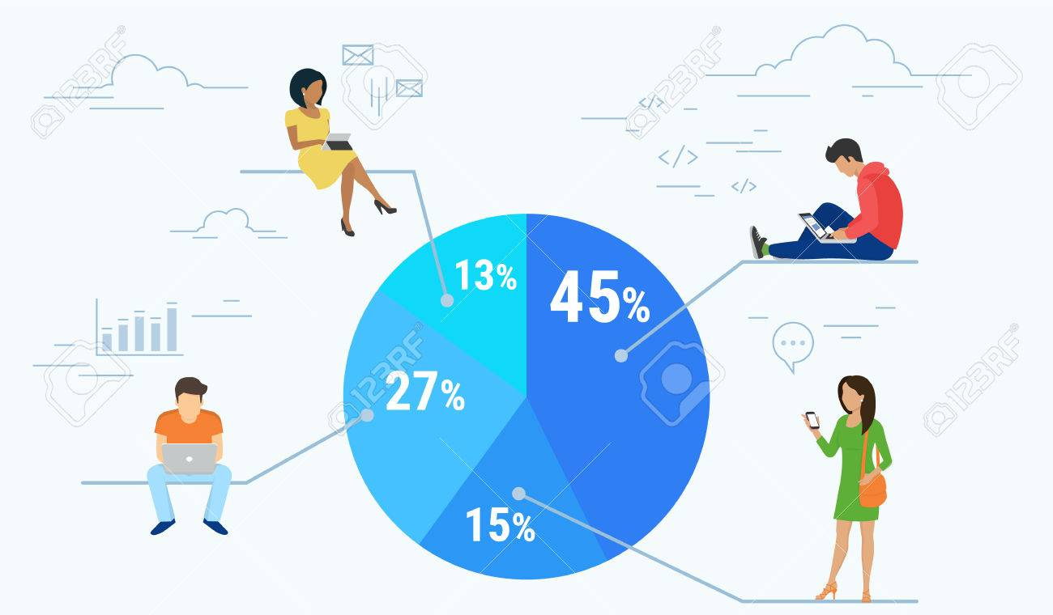
Motivation
Commercial and wide market application.

Slide 5

Motivation
Different Computer Engineering fields
Image Processing
Deep Learning
Big Data Analytics and Mining

Slide 6


Slide 7
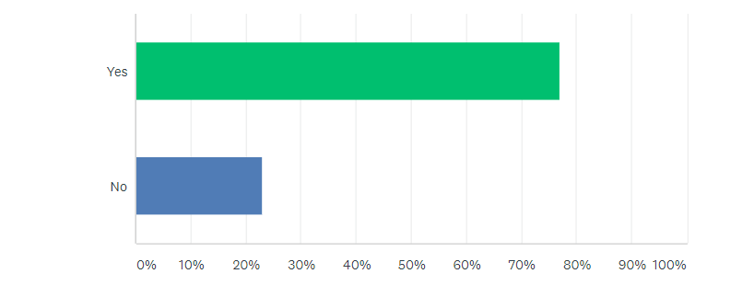
Market Survey
Question 1: Have you ever experienced buying a piece of clothes and then did not find any pieces matching
with it?
Around 80% of the respondents face this shopping problem.

Slide 8
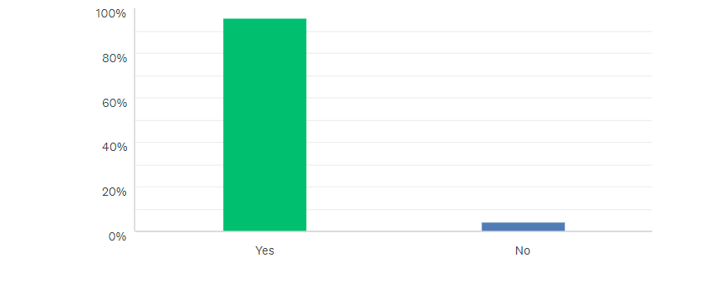
Market Survey
Question 2: Have you ever experienced seeing a piece of clothes, a pair of shoes, a bag or a scarf
that you like but did not know where to find it?
96% of the respondents face this shopping problem.

Slide 9
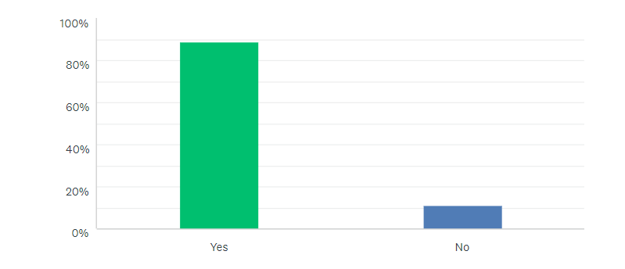
Market Survey
Question 3: Would you like to have an application that aids you in the shopping problems described in the
three previous questions?
90% of the respondents will use the application to help them in the shopping problems.

Slide 10
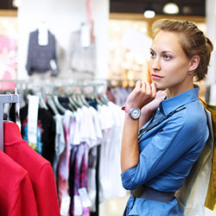
Problem Definition
Cannot find a certain piece of clothes.
Want outfits with a certain style.
Cannot find a matching piece with a certain piece of clothes.
Don’t know the trending colors and outfits.

Slide 11
Proposed Solution
Application Main Features:
Find similar pieces.
Find similar outfits.
Find matching pieces.
Find Now-Trending colors and outfits.

Slide 12
Proposed Solution
Solution that saves the user:
Time
Effort
Money

Slide 13
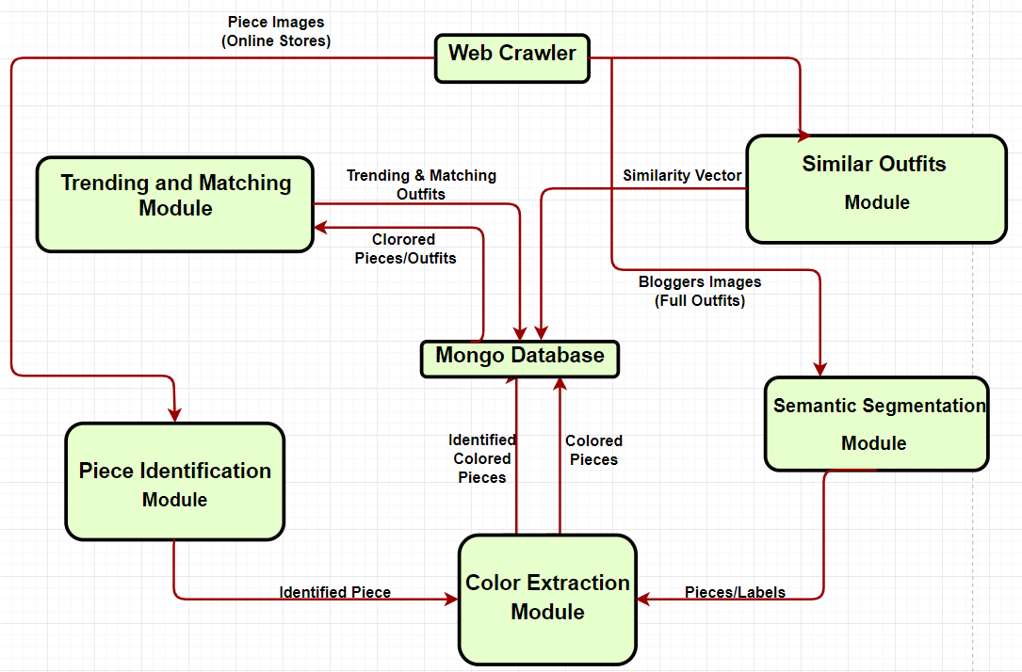
Block Diagram

Slide 15
Crawler Module

Slide 16
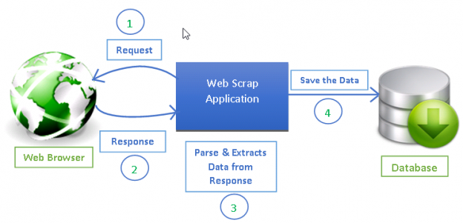
Overview

Slide 17
Objective
Crawler
Retrieve purchasable products
Discover current trends
Notes:
A critical module to make the application commercially feasible.

Slide 18



Retrieve Purchasable Products
Crawled websites
Notes:
Custom crawler for each

Slide 19
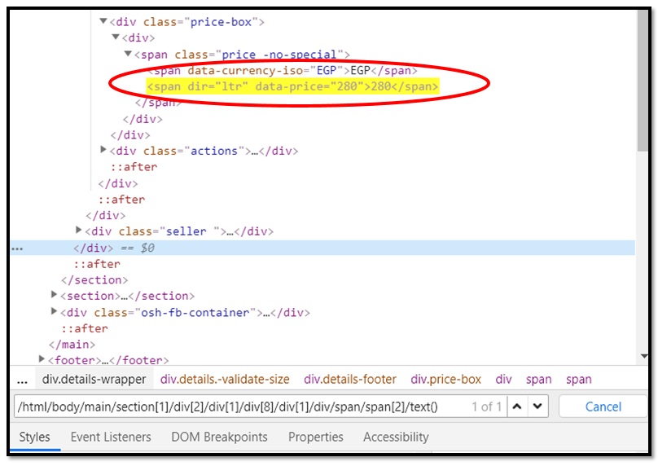
Retrieve Purchasable Products
Retrieved information samples:
Image
Type of clothing
Price
Fabric

Slide 20
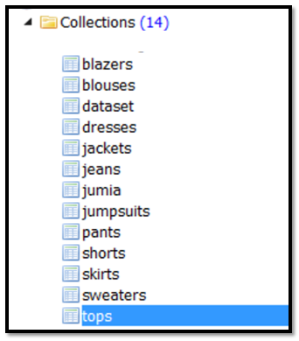
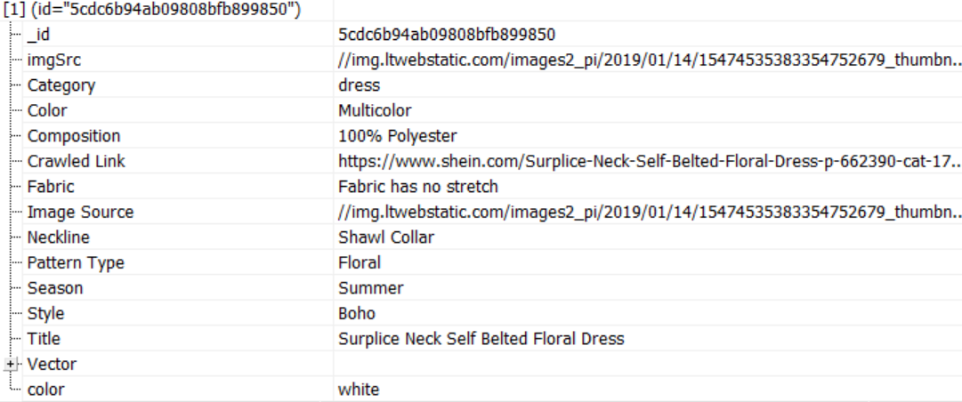
Retrieve Purchasable Products
NoSQL Based Database Design

Slide 21



Discover Current Trends
Crawled websites
Magazines
Fashion Bloggers
Notes:
Custom crawler for each of:
Fashion central Pakistan
Femina Indonesia
Instagram crawler using username

Slide 23
Segmentation Module

Slide 24
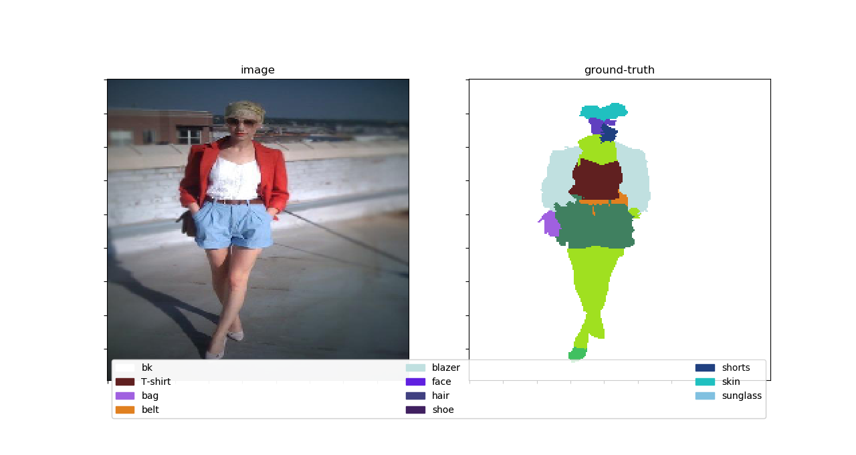
Objective

Slide 25
Package Design
Segmenter
Dataset
Khurana
CFPD
Model
FCN8
Texture
Fused Model
Testing
Visualize
Confusion Matrix

Slide 26
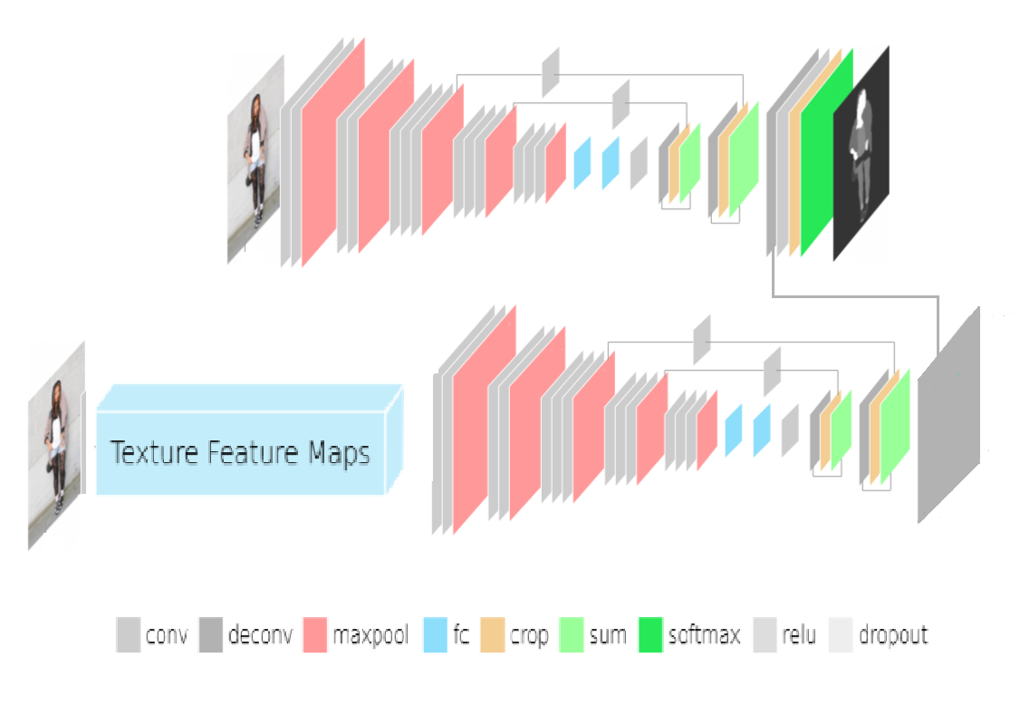
Model Architecture

Slide 27
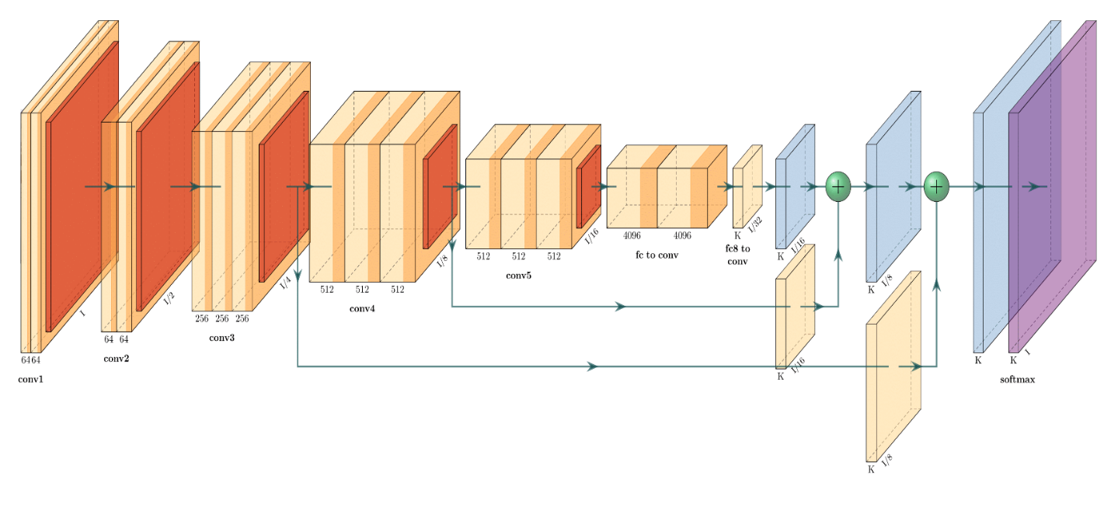
FCN-8 Architecture

Slide 28
Stream Inputs

Slide 29
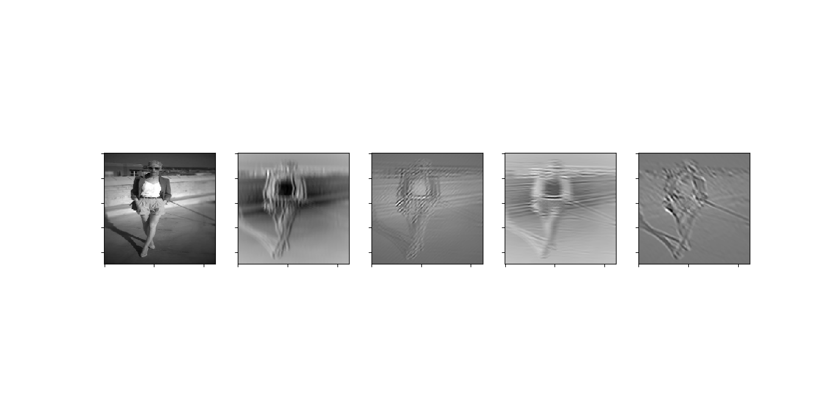
Stream Inputs

Slide 30
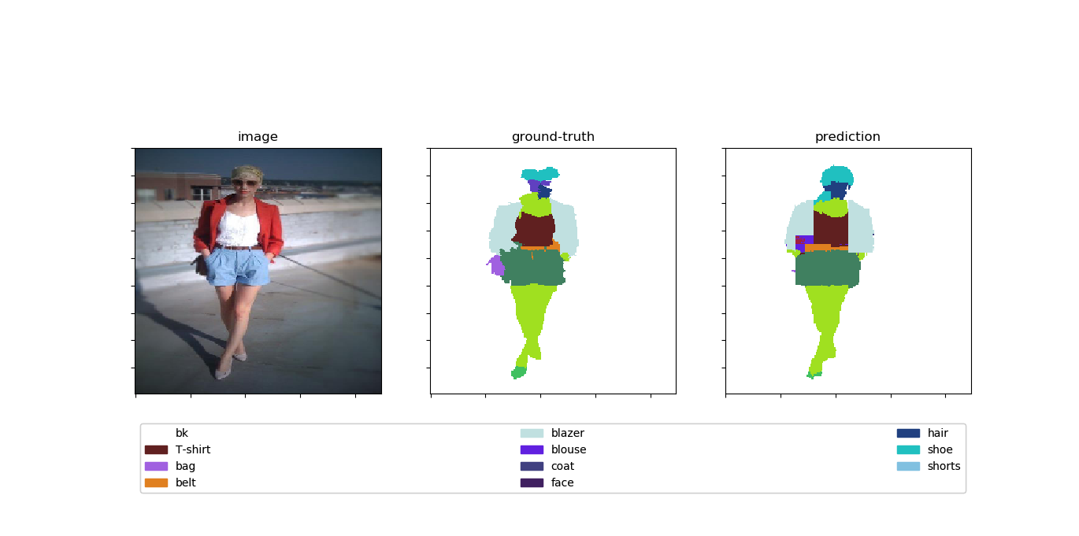
Model Output

Slide 32
Piece Segmentation Module

Slide 33
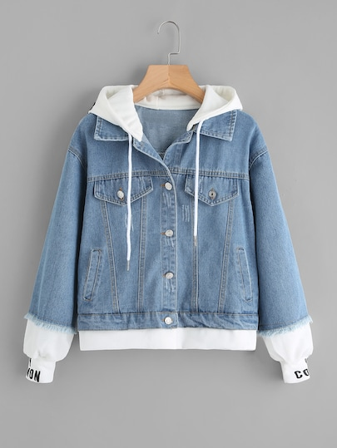
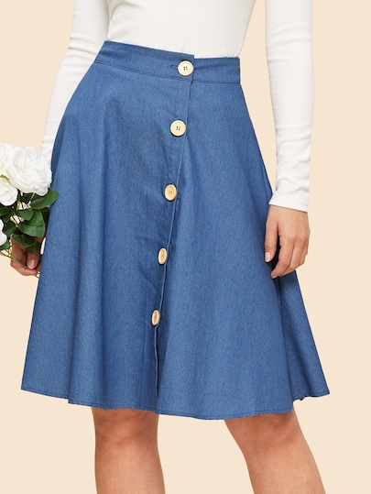
Piece Segmentation Model

Slide 34
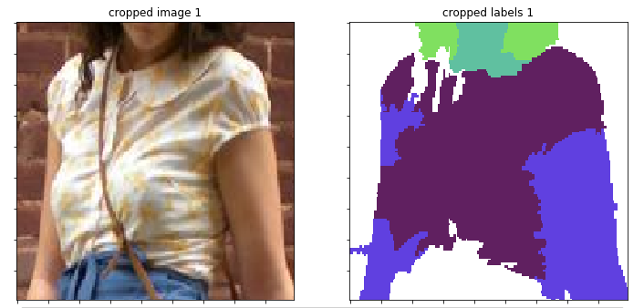
Piece Segmentation Model

Slide 36
Color Model Extraction

Slide 37
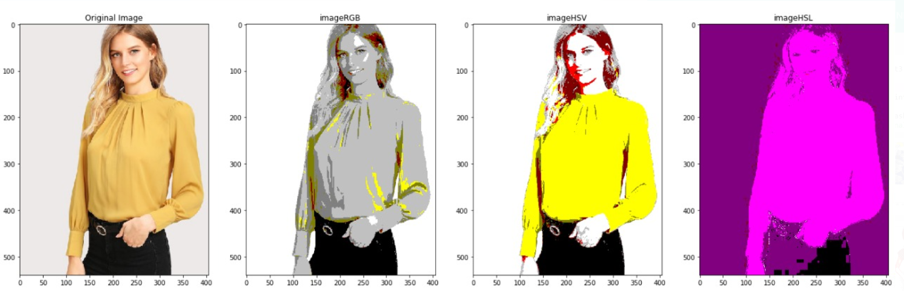
Color Extraction Module

Slide 38
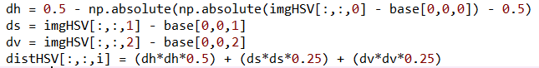
Color Extraction Module
Color Distance Calculation

Slide 39
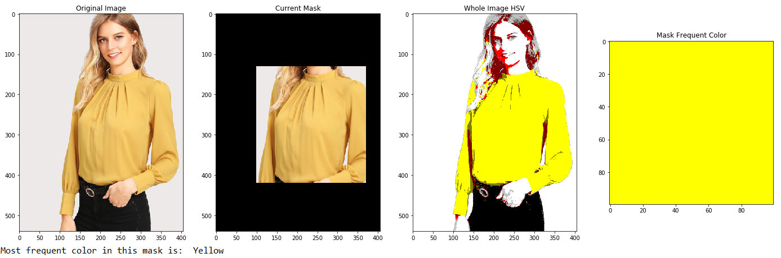
Color Extraction Module
2 Pieces Per Image Example

Slide 40
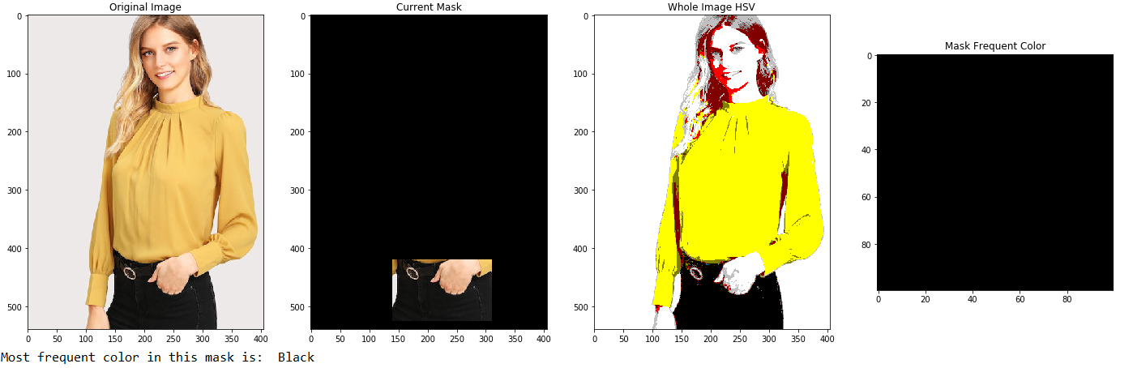
Color Extraction Module
2 Pieces Per Image Example

Slide 41
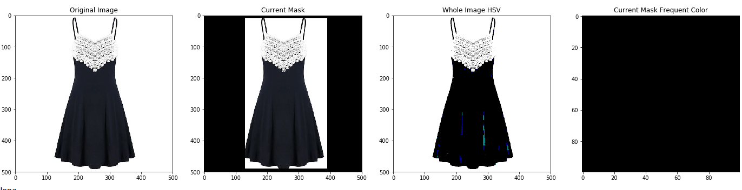
Color Extraction Module
Single Piece Image Example

Slide 43
Similarity Module

Slide 44
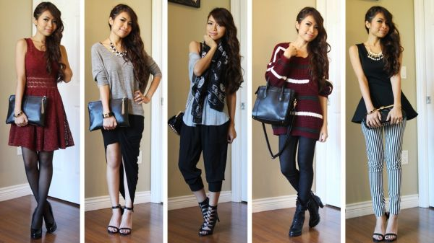
Similarity Module
Different styles of outfits

Slide 45
Similarity Module
Compute similarity feature vector
Get top N similar outfits

Slide 46

Computing Similarity Feature vector
Deep CNN

Slide 47
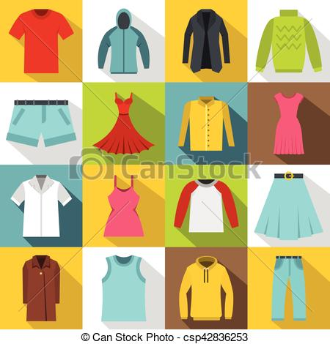
Semantic Compositional Networks
A Semantic Compositional Network (SCN) is developed for image captioning, in which semantic concepts (i.e., tags) are detected from the image, and the probability of each tag to exist in the image.

Slide 48
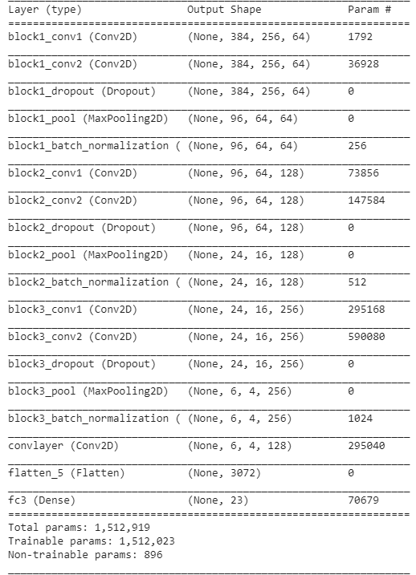
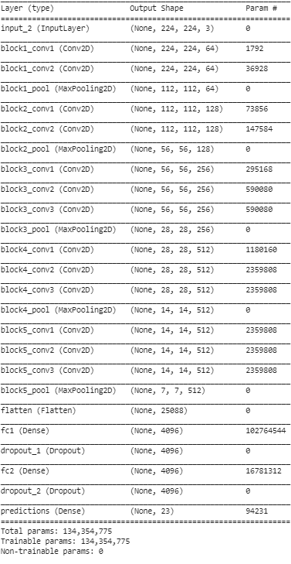
CNN Architecture
VGG Model | Our Model

Slide 49
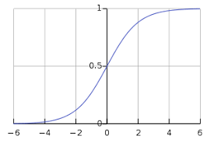
Activation Function
Sigmoid

Slide 50
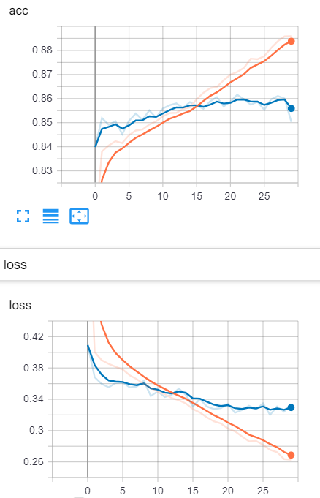
Training
Training accuracy: 87%
Validation accuracy: 85%

Slide 51
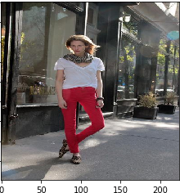
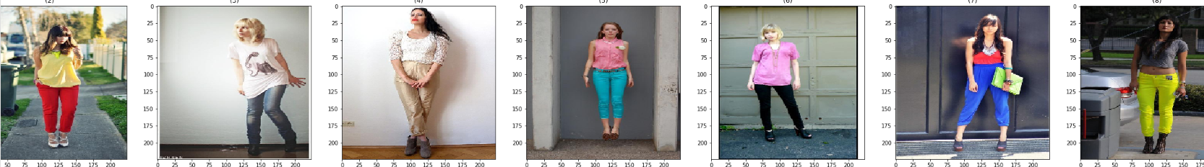
Results

Slide 52
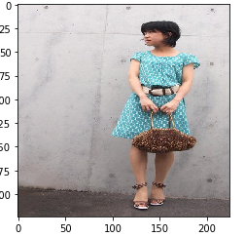
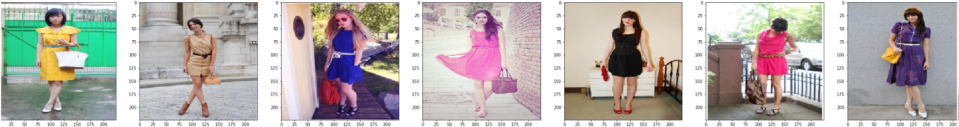
Results

Slide 54
Pieces Identification

Slide 55
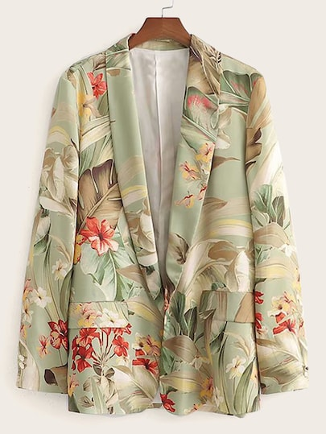
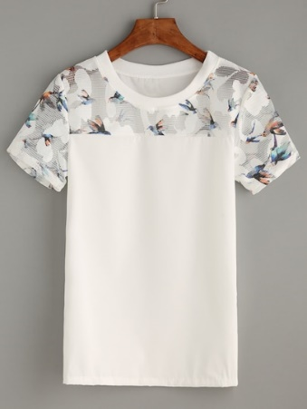
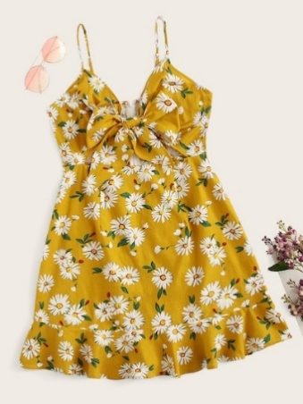
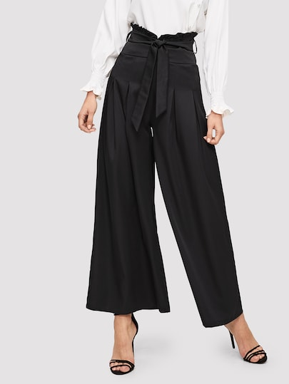
Single-Label Multi-Class Classification

Slide 56
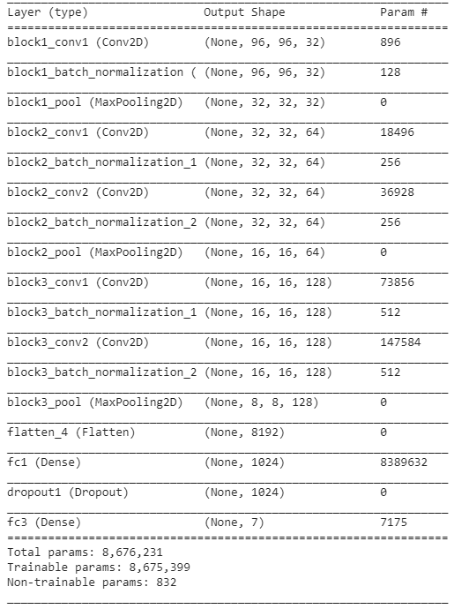
CNN Architecture

Slide 57
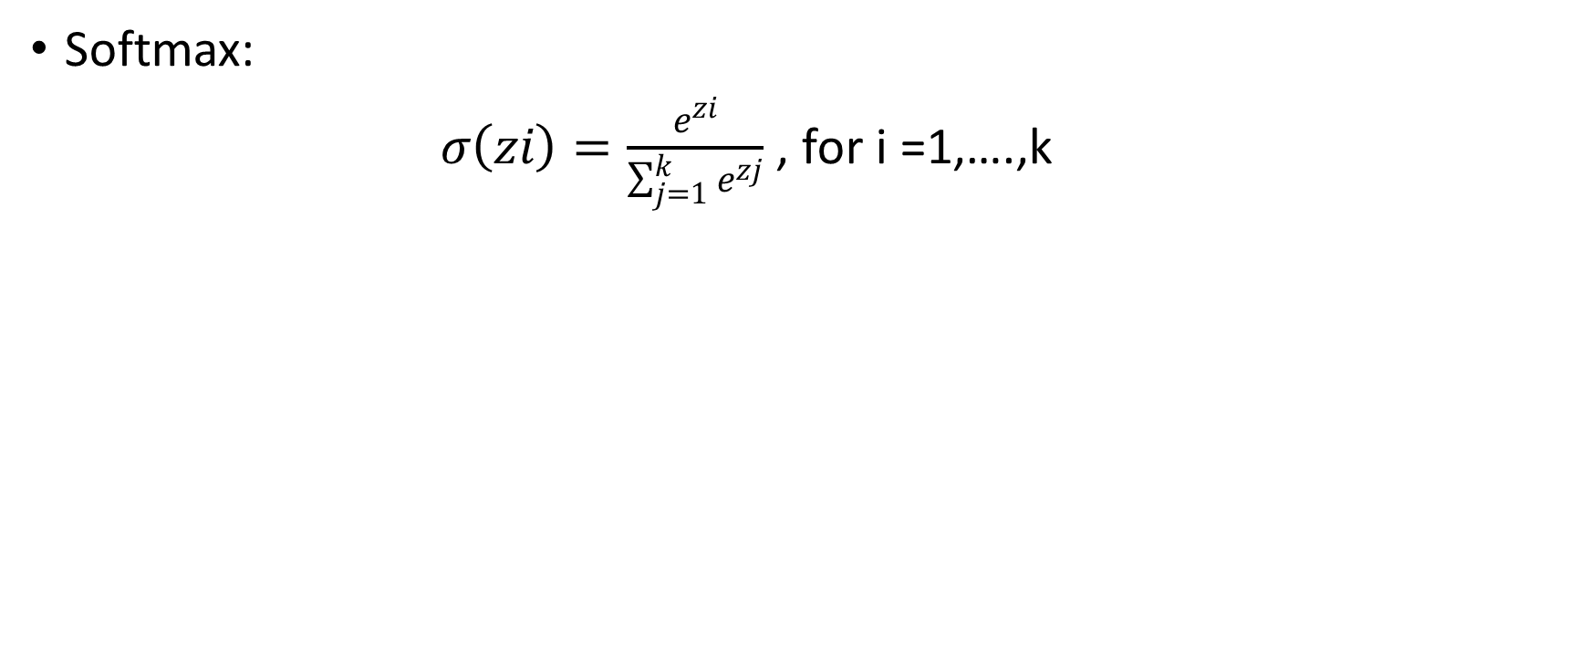
Activation Function
Softmax:
$σ\left(zi\right)=\frac{e^{zi}}{\sum_{j=1}^{k}{e^{zj}}}$ , for i =1,….,k

Slide 58
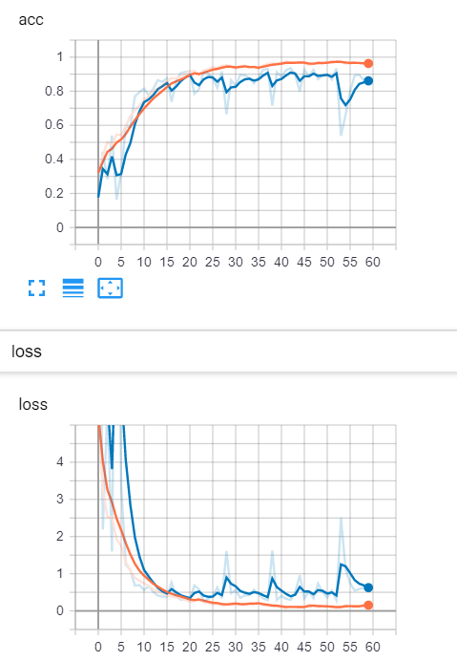
Results & Training
Training Accuracy: 93%
Validation Accuracy: 90%
Test Accuracy: 89%

Slide 60
Database

Slide 61
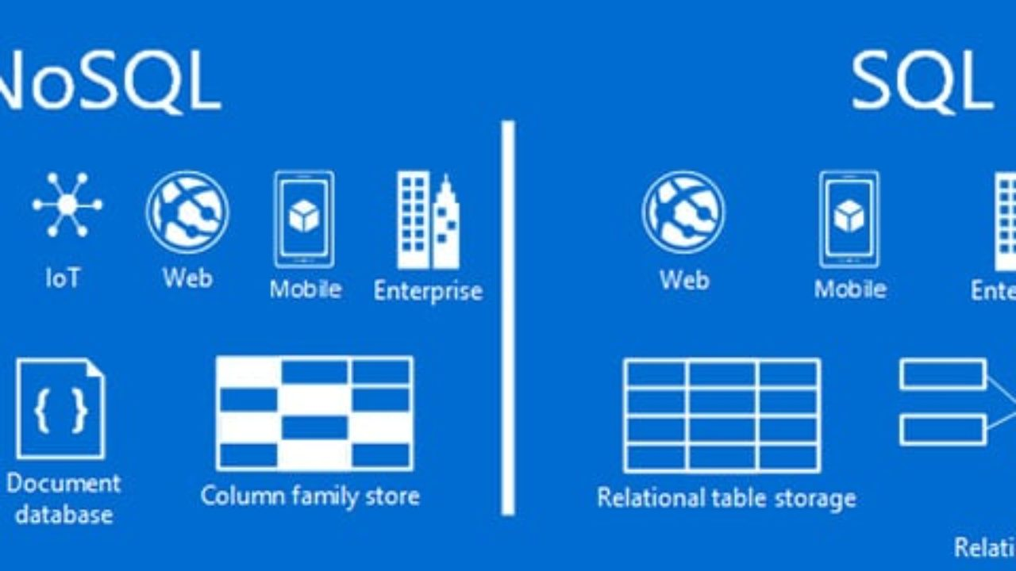
NO SQL Database
Unstructured nature of data

Slide 62
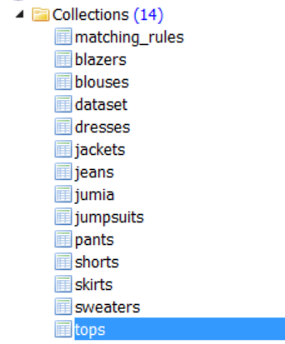
Database

Slide 64
The Trending and Matching Module

Slide 65
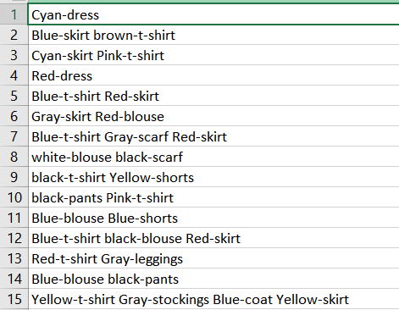
Module’s Input

Slide 66
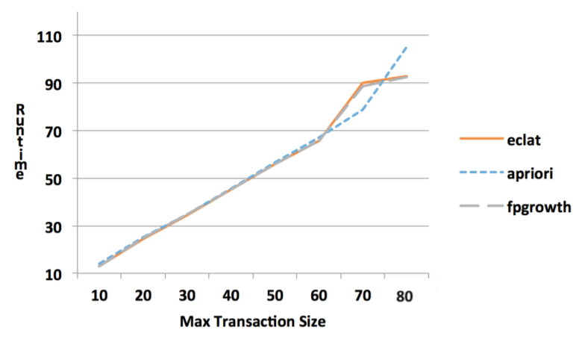
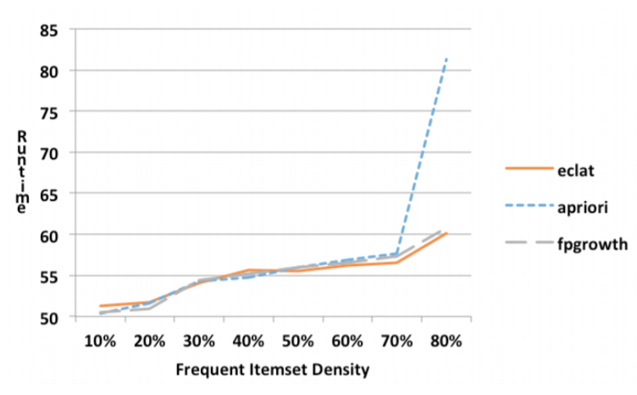
Algorithms Used
1) ”Apriori” Algorithm: Breadth-First search strategy to count the support of item sets
2) “Eclat” Algorithm: Depth-First search strategy to count the support of item sets

Slide 67
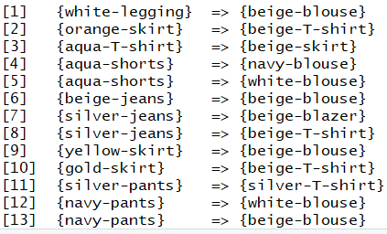
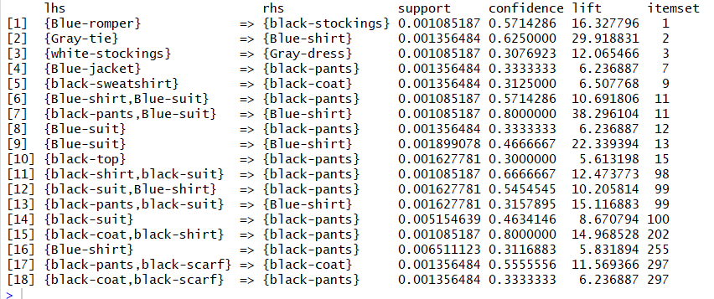
Module’s Output
1) Outfit Matching Rules

Slide 68
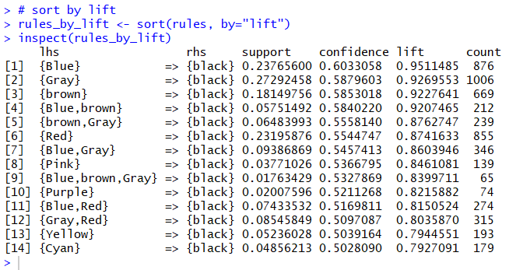
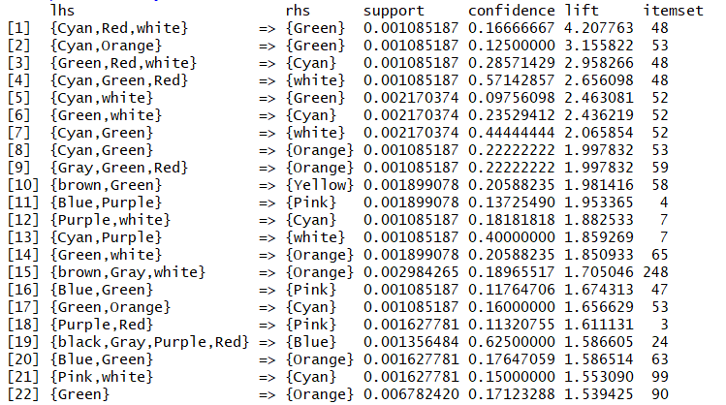
Module’s Output
2) Trending Colors Matching Rules

Slide 69


Module’s Output
3) Most trending colors in every clothes’ categories

Slide 70



Results’ Evaluation: Outfit Matching Rules
Lift Measure
RPF Measure
Conviction Measure

Slide 71



Results’ Evaluation: Trending Colors Matching Rules
Lift Measure
RPF Measure
Conviction Measure

Slide 72

The Integration

Slide 73


The Mobile Application
React Native
Android
iOS

Slide 74




The Mobile Application
Who is using React Native?
Instagram
Facebook
Skype
Pinterest

Slide 75


The Mobile Application
Android Version
iOS Version

Slide 76

Scenario 1 - Match an Outfit
Step 1

Slide 77

Scenario 1 - Match an Outfit
Step 2

Slide 78

Scenario 2 – Find Similar Pieces

Slide 79

Scenario 3 – Find Similar Outfits

Slide 80

Scenario 4 : Now Trending

Slide 81
Future Work
Extra Features: Patterns, Fabrics
In-Store Pieces Placement/Organization
Online shopping cross-selling
Making contracts with the shopping stores

Slide 82

Conclusion

